Slide 1
Linear and Ensemble Methods
CSCI 4360/6360 Data Science II

Slide 2
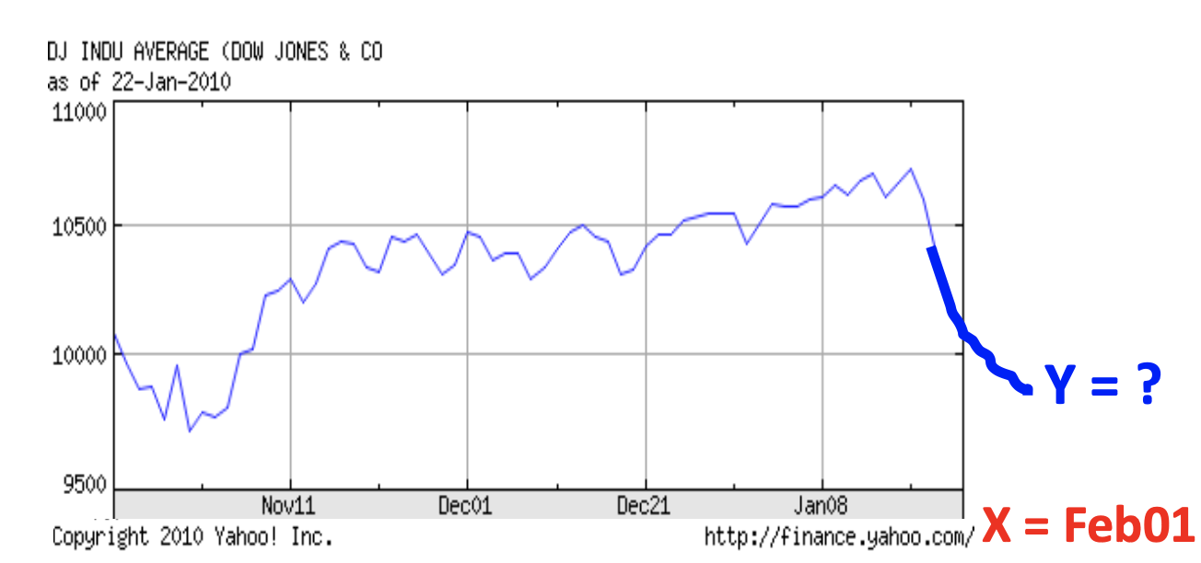
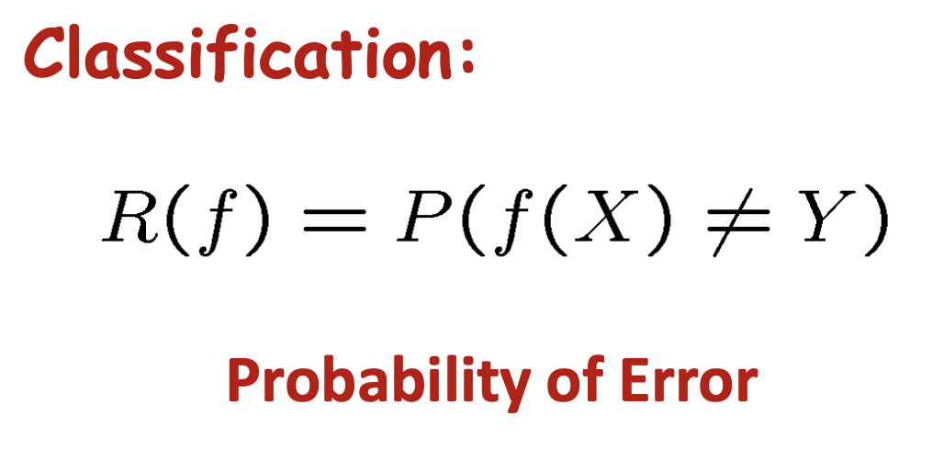
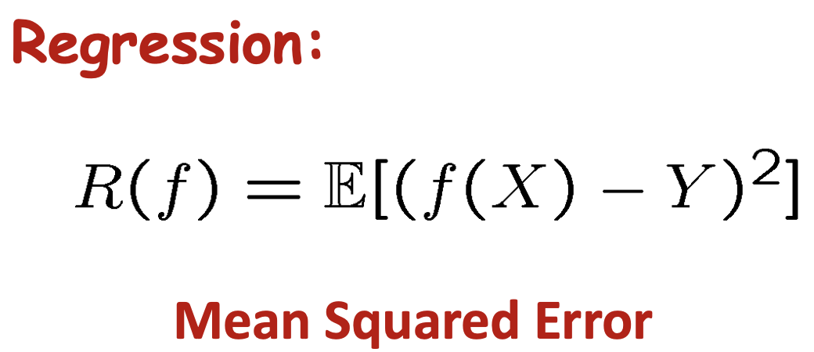
In general, the goal:
Construct a predictor f: X -> Y that minimizes risk R(f)

Slide 3
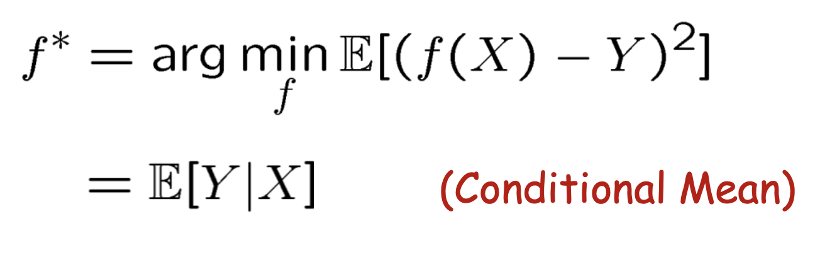
Optimal [regression] predictor

Slide 4
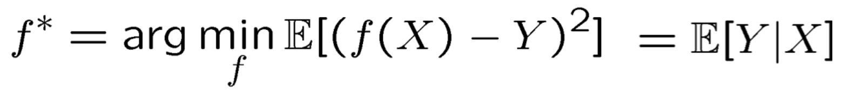
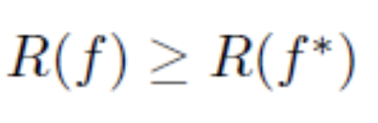
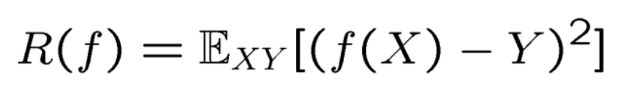
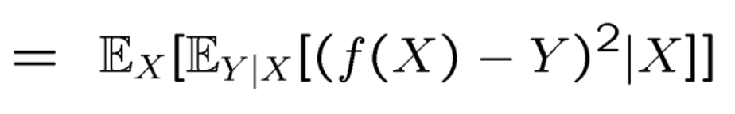
We can prove this!
Therefore, for any prediction rule f
We define R(f)
Expand according to axiom of conditional probability

Slide 5
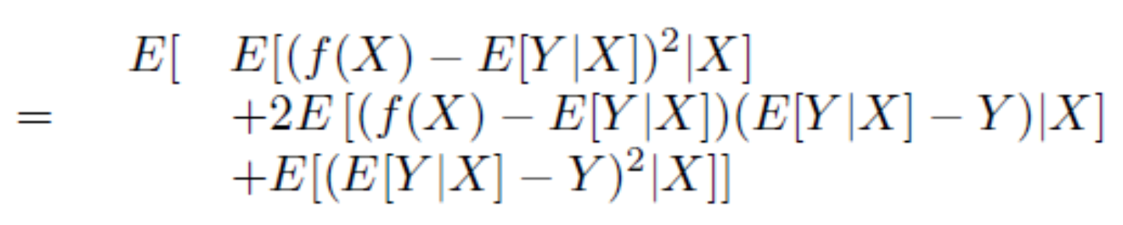
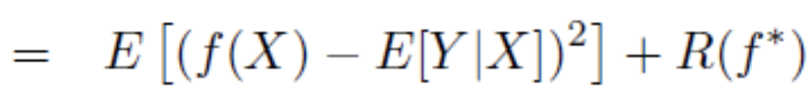
It escalates quickly…
(dropping subscripts for convenience)
Multiplying out the quadratic term

Slide 6
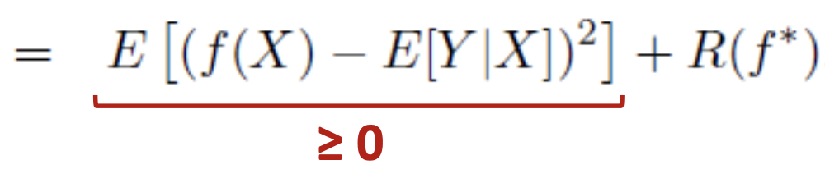
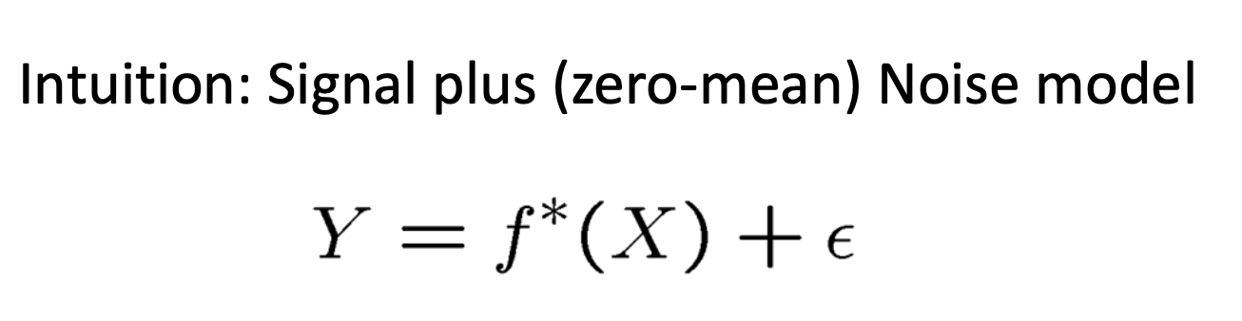
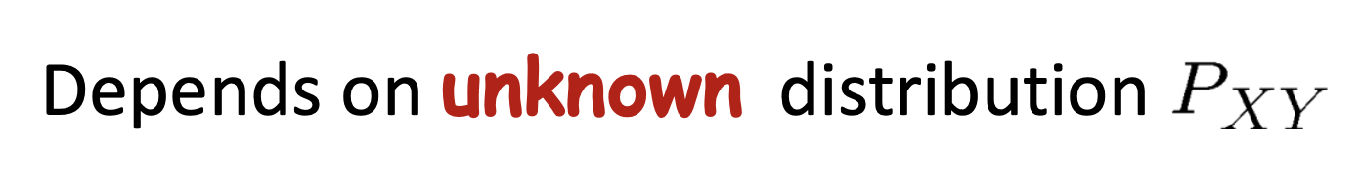
Finally…

Slide 7
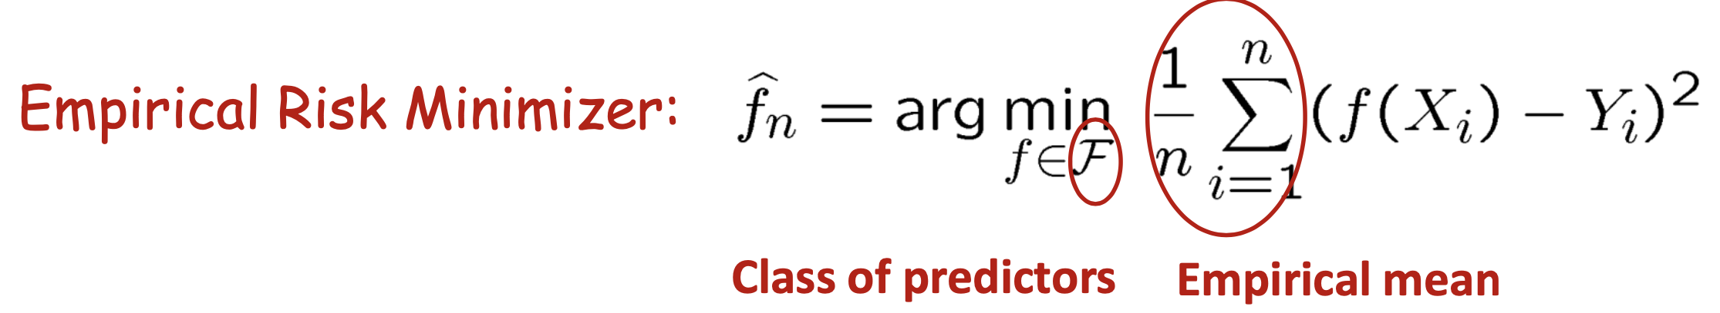
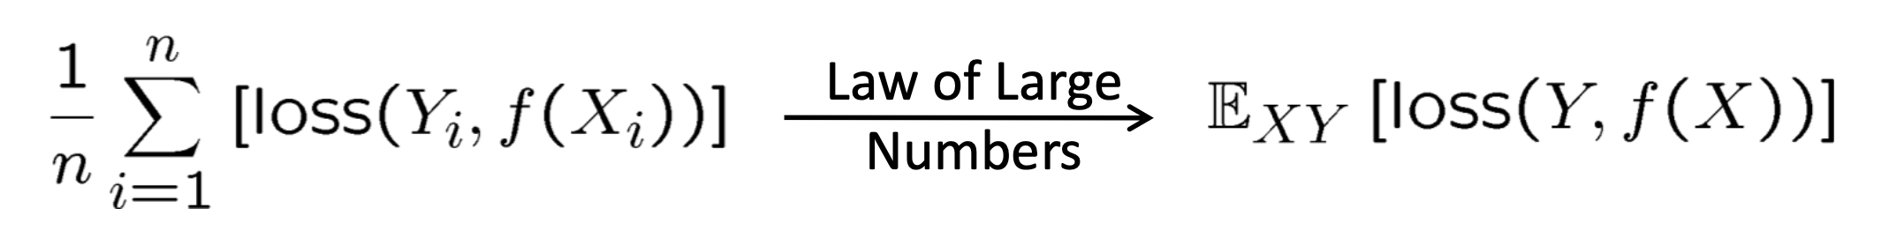
Empirical Risk Minimization (EMR)
Since we don’t have direct access to the unknown distribution P(X, Y), we rely on statistics

Slide 8
Part I: Linear Models

Slide 9
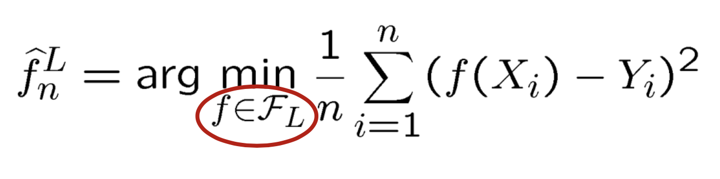
Linear Models
Means each f in F_{L} is restricted to a class of linear functions (in X)

Slide 10
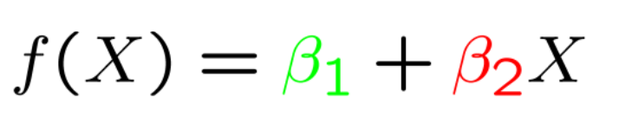
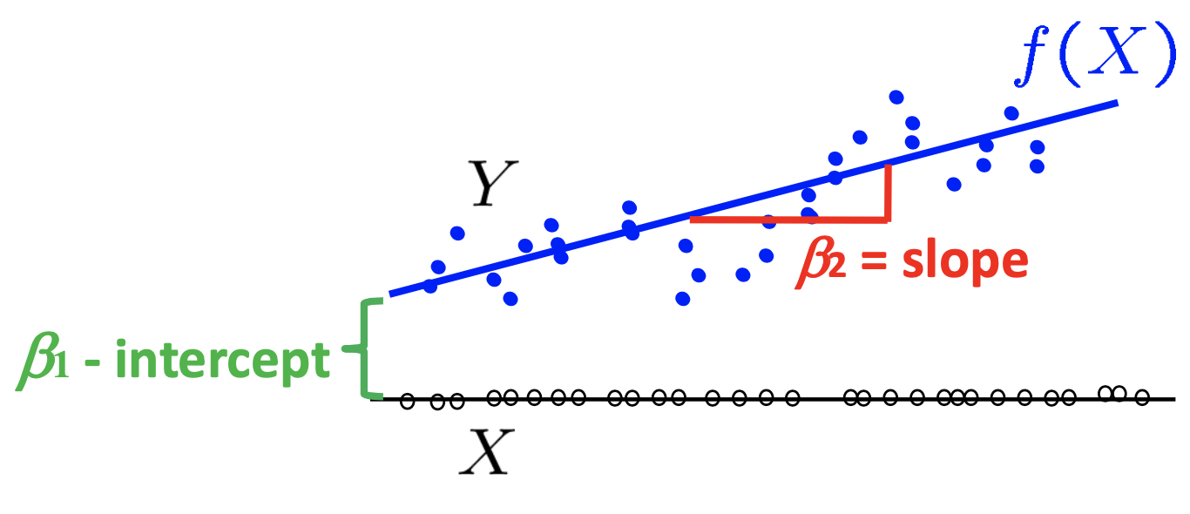
Univariate case
You’ve seen this a million times…

Slide 11
Multivariate case
where

Slide 12
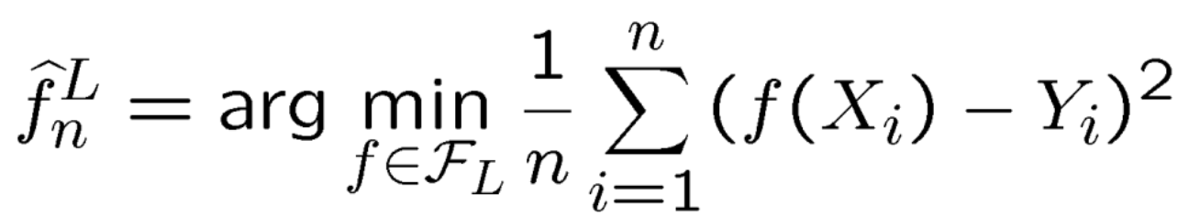
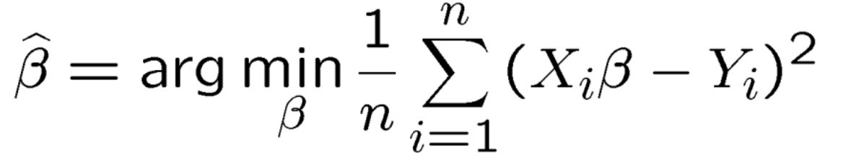
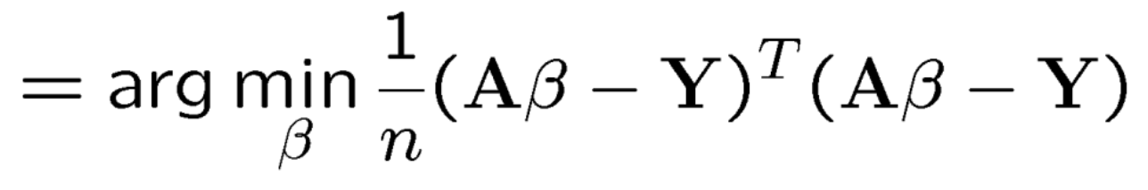
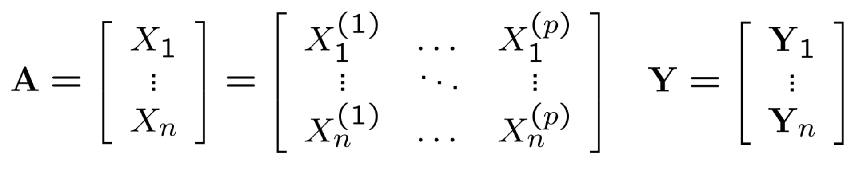
Finding the estimator
Back to our original equation
Substitute in our line parameters
Expand the square
where

Slide 13
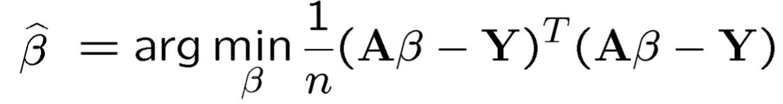
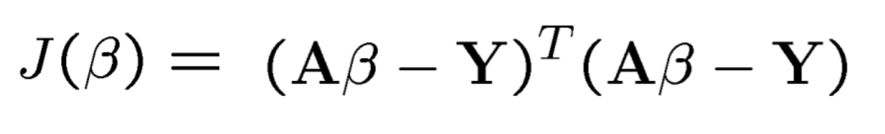
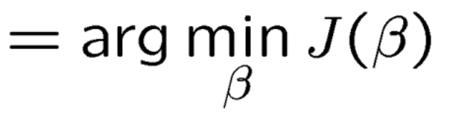
Finding the estimator

Slide 14
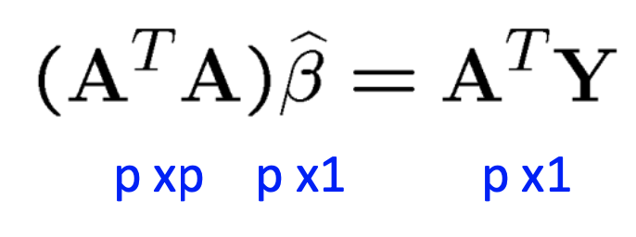
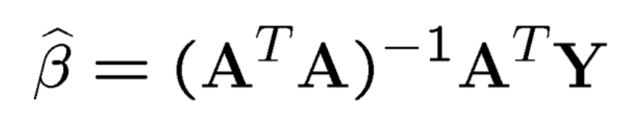
Normal Equations
If (A^{T}A) is invertible, this is easily solved!
When is (A^{T}A) invertible?
When A is full rank (recall Linear Algebra Review lectures)

Slide 15
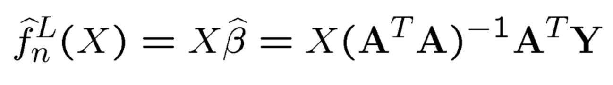
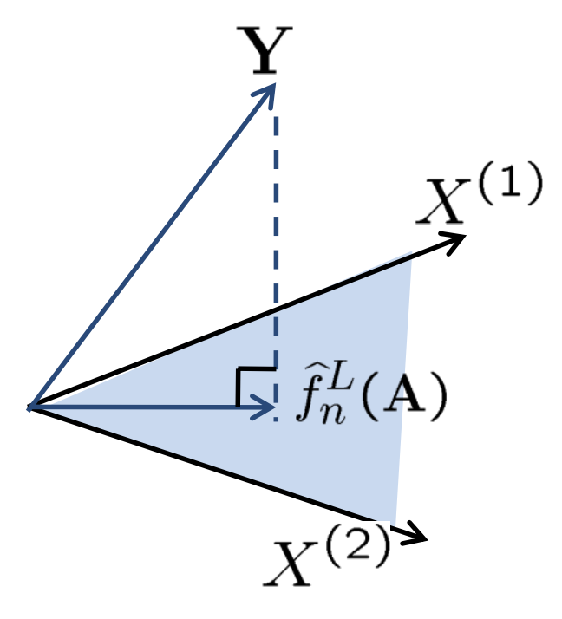
Geometric Interpretation
f_{n}(A) is the orthogonal projection of Y onto the linear subspace spanned by the columns of A (aka X)
(go back and review the Linear Algebra notes!)

Slide 16
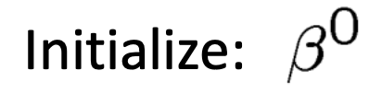
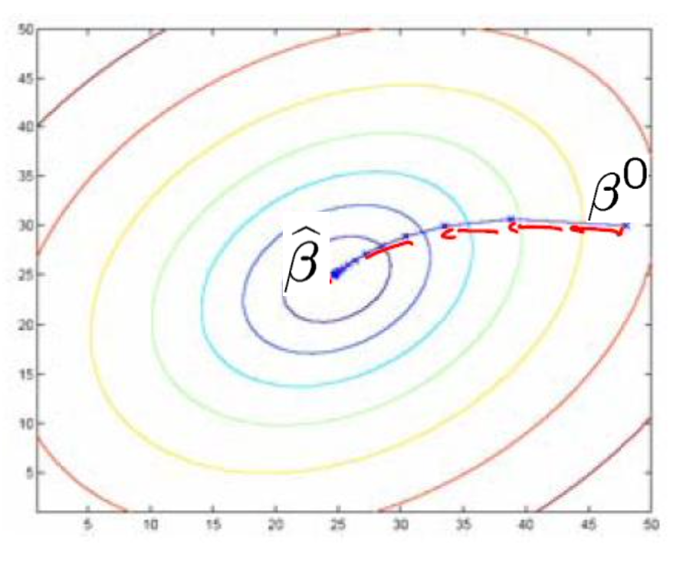
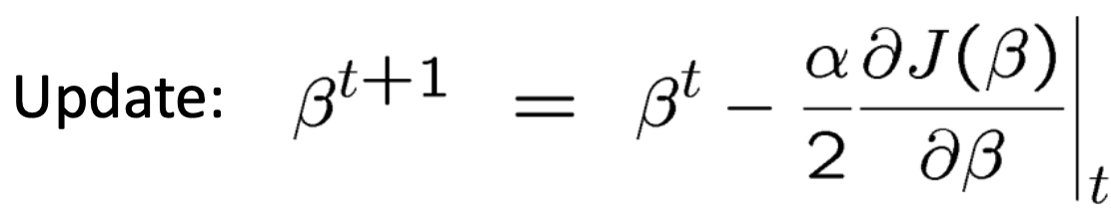
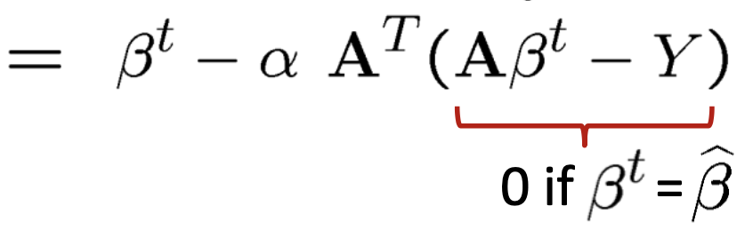
Normal Equations
We saw how to solve when (A^{T}A) is invertible
Unspoken was the assumption that it is also small
What about when (A^{T}A) is invertible, but very large?
Gradient descent! J(β) is convex!

Slide 17
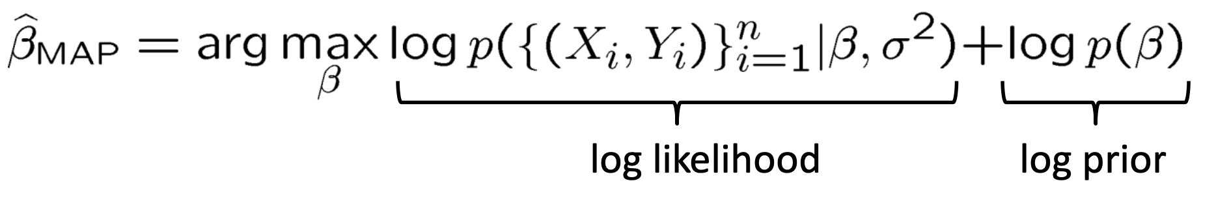
Normal Equations
What about when (A^{T}A) is not invertible?
Prior + regularization

Slide 18
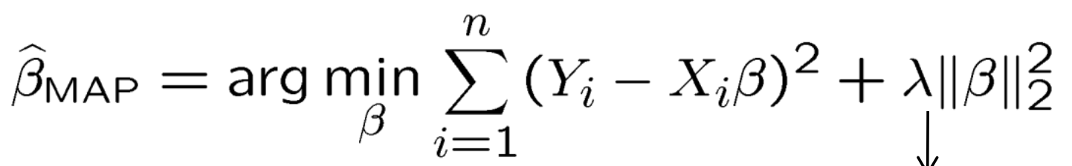
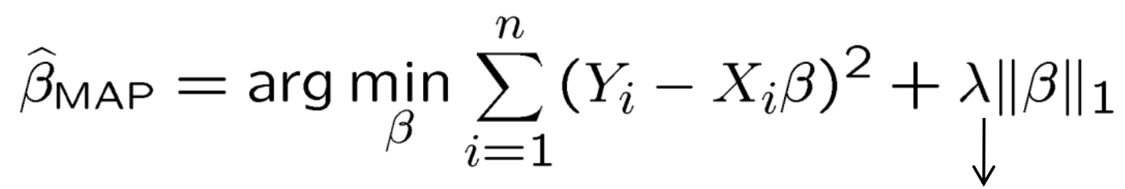
Non-invertible case
What kinds of priors?
Gaussian prior
Laplace prior
What’s the difference?

Slide 19
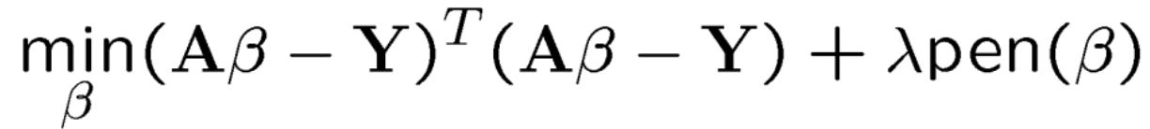
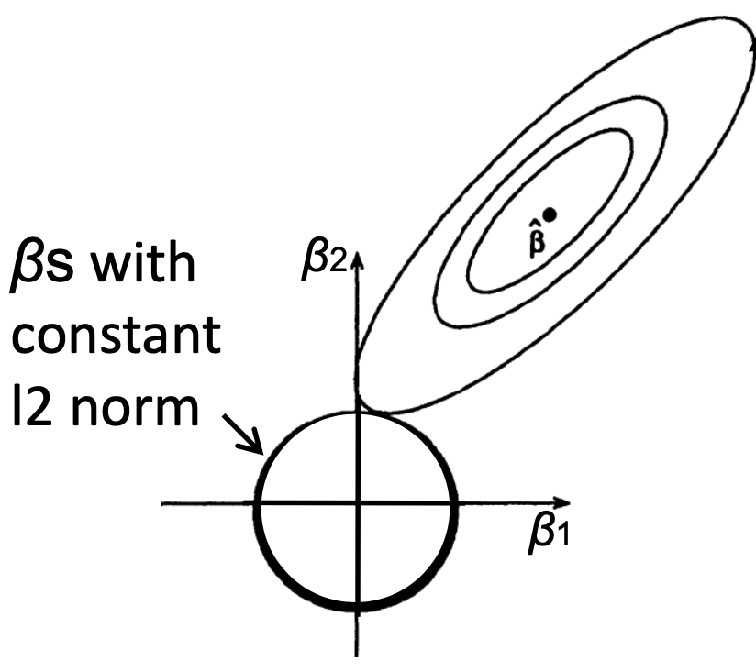
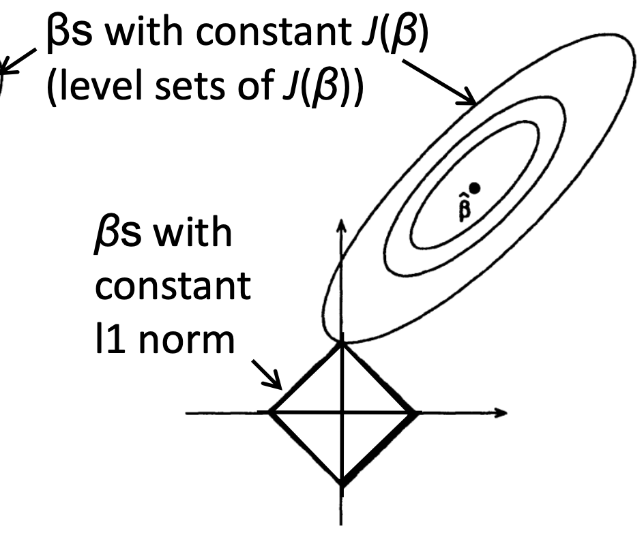
Types of regularization
Ridge regression (L2)
Lasso regression (L1)
L1 (Lasso) results in sparse solutions
Very good for high-dimensional problems!

Slide 20
Part II: Ensemble Models

Slide 21
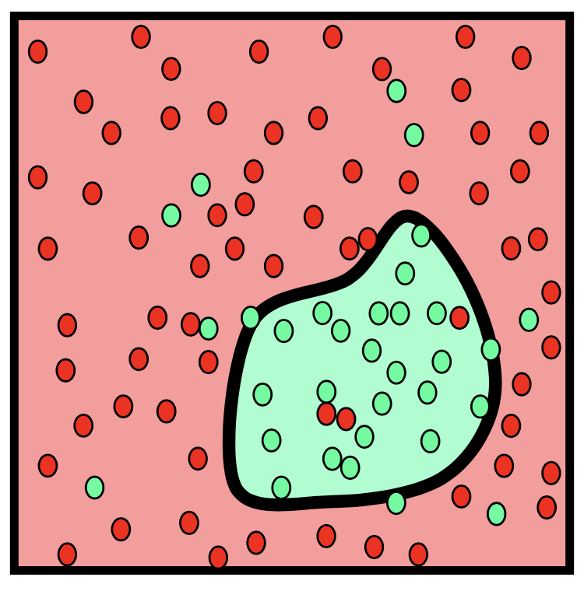
Nonlinear decision boundaries
Sometimes we encounter problems that linear models can’t solve

Slide 22
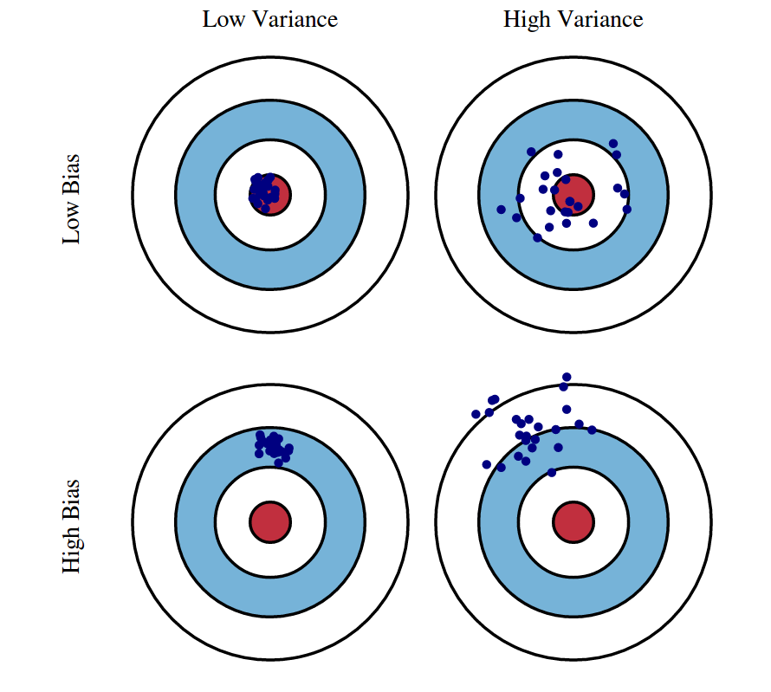
Bias-variance trade-off
Bias
E[θ – X]
Deviation of the estimator from the true value on average
Variance
E(X²) – E(X)²
Spread of the data from its average
As one decreases, the other tends to increase
Low-bias, low-variance is not generally possible

Slide 23
Ensemble Models
Collections of “weak learners”
Decision Trees -> Random Forests
Logistic Regression -> Pool of Logistic Regressors
Naïve Bayes -> Ensemble of Naïve Bayes
Support Vector Machine -> Ensemble of SVMs
Each is trained independently on a subset of the training data
Decisions are made by pooling all the individual models’ predictions
Instead of learning a single (weak) classifier, learn many (weak) classifiers that are good at different parts of the input space

Slide 24
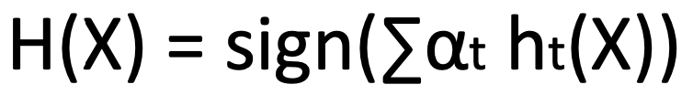
Boosting
Given a weak learner, run it multiple times on (reweighted) training data, then let learned classifiers vote
On each iteration t:
weight each training example by how incorrectly it was classified
learn a weak hypothesis (classifier) h_{t}
a strength of the hypothesis ɑ_{t}
Final classifier

Slide 25
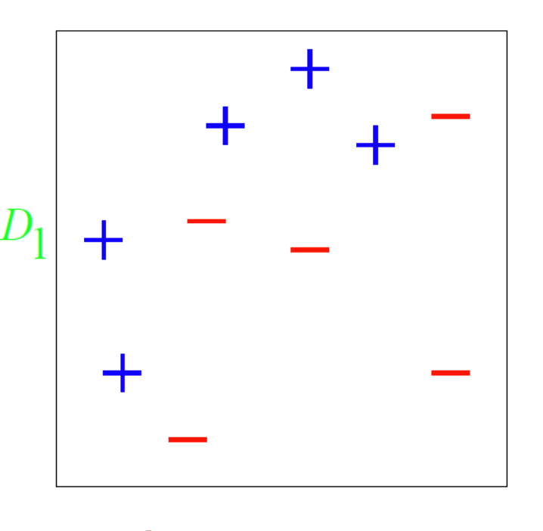
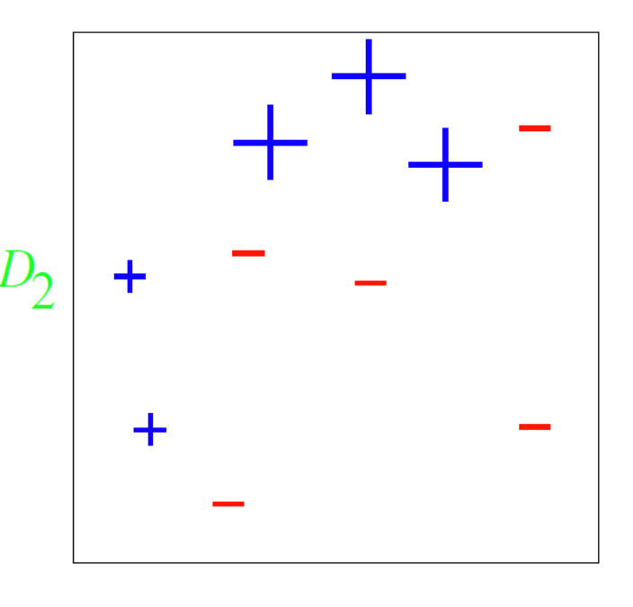
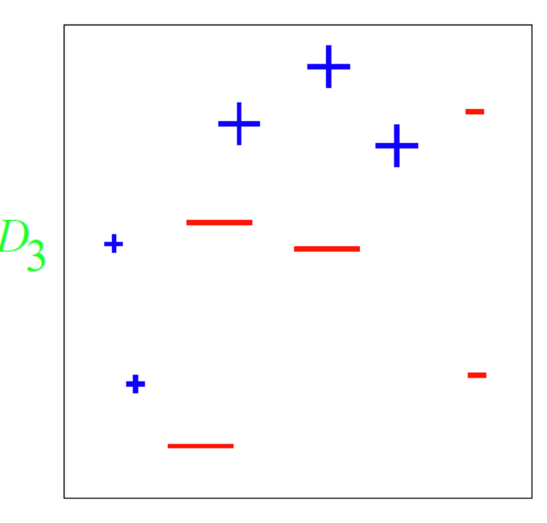
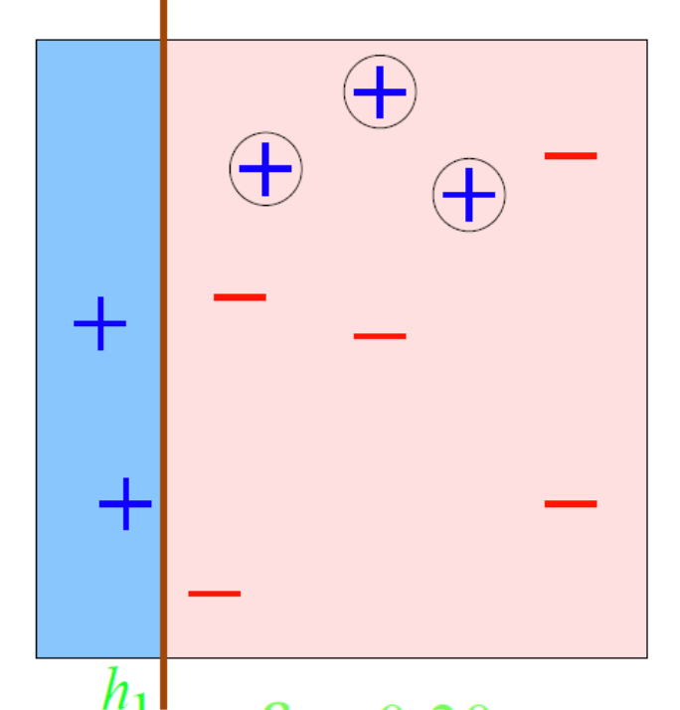
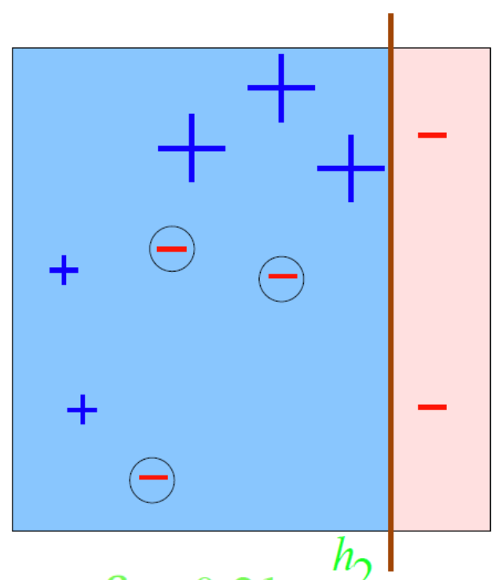
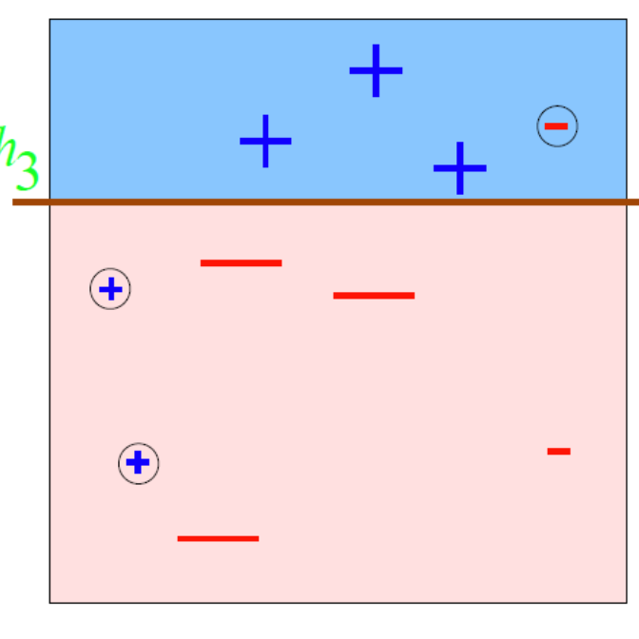
Boosting example
Notes:
Error decreases on each iteration as a function of the _reweighted_ data

Slide 26
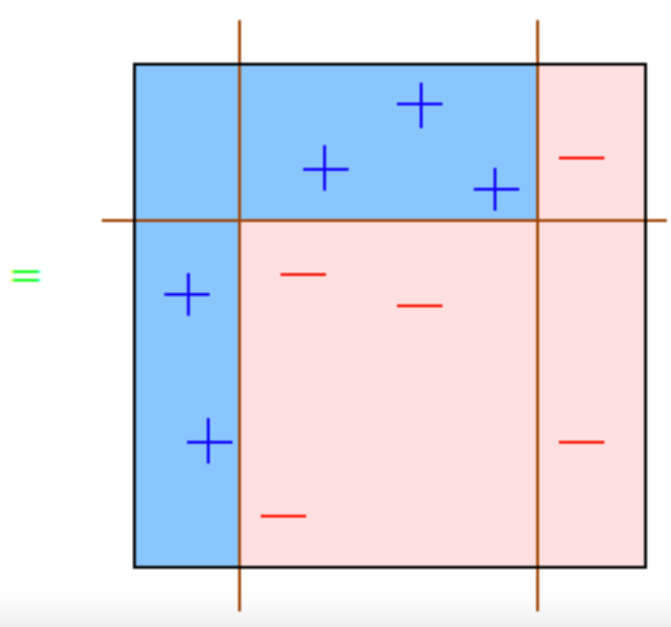
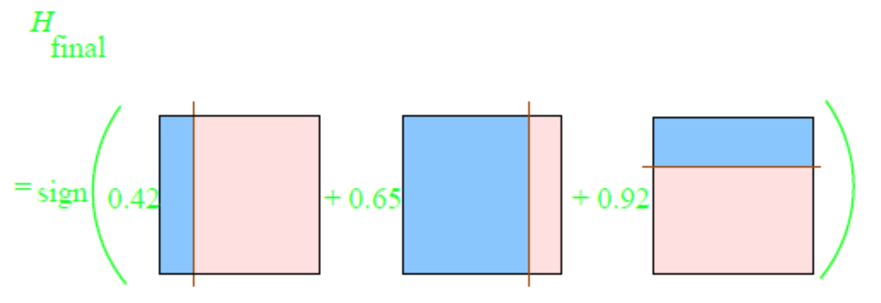
Boosting example

Slide 27
Part III: xgboost

Slide 28

XGBoost
eXtreme Gradient Boosting
29 Kaggle challenges with winners in 2015
17 used XGBoost
8 of these solely used XGBoost; the others combined XGBoost with DNNs
KDDCup 2015
Every single top 10 finisher used XGBoost

Slide 29
XGBoost Applications
Store sales prediction
High energy physics event classification
Web text classification
Customer behavior prediction
Motion detection
Ad click through rate prediction
Malware classification
Product categorization
Hazard risk prediction
Massive on-line course dropout rate prediction

Slide 30
Properties of XGBoost
Single most important factor in its success: scalability
Due to several important systems and algorithmic optimizations
Highly scalable end-to-end tree boosting system
Theoretically justified weighted quantile sketch for efficient proposal calculation
Novel sparsity-aware algorithm for parallel tree learning
Effective cache-aware block structure for out-of-core tree learning
Notes:
While there are some existing works on parallel tree boosting, the directions such as out-of-core computation, cache-aware and sparsity-aware learning have not been explored. More importantly, an end-to-end system that combines all of these aspects gives a novel solution for real-world use-cases.
we also make additional improvements in proposing a regularized learning objective

Slide 31


What is “tree boosting”?
Given a dataset (n examples, m features)
Tree ensemble uses K additive functions to predict output
Notes:
F is the space of regression trees
Structure of each tree q maps an example to corresponding leaf index; each f_k is an independent tree structure and leaf weights w
Each q maps m-feature data point to T leaves
Regression trees contain a continuous score on each leaf, and w_i is the score on the i^th leaf (unlike decision trees)

Slide 32
What is “gradient boosting”?

Slide 33





Regularized objective function
Objective
2nd order approx.
Remove constants
Scoring function to evaluate quality of tree structure
Notes:
Here l is a differentiable convex loss function that measures the difference between the prediction yˆi and the target yi. The second term Ω penalizes the complexity of the model (i.e., the regression tree functions) (T is number of leaves, w the weights).
The additional regularization term helps to smooth the final learnt weights to avoid over-fitting
Intuitively, the regularized objective will tend to select a model employing simple and predictive functions
A similar regularization technique has been used in Regularized greedy forest (RGF) [25] model.
Our objective and the corresponding learning algorithm is simpler than RGF and easier to parallelize. When the regularization parameter is set to zero, the objective falls back to the traditional gradient tree boosting.
This score is like the impurity score for evaluating decision trees, except that it is derived for a wider range of objective functions.

Slide 34

Regularized objective function
Notes:
I_j is the instance set of leaf j.

Slide 35
Split-finding algorithms
Exact
Computationally demanding
Enumerate all possible splits for continuous features
Approximate
Algorithm proposes candidate splits according to percentiles of feature distributions
Maps continuous features to buckets split by candidate points
Aggregates statistics and finds best solution among proposals

Slide 36

Comparison of split-finding
Two variants
Global
Local
Notes:
The global variant proposes all the candidate splits during the initial phase of tree construction, and uses the same proposals for split finding at all levels. The local variant re-proposes after each split.
The global method requires less proposal steps than the local method. However, usually more candidate points are needed for the global proposal because candidates are not refined after each split.
The local proposal refines the candidates after splits, and can potentially be more appropriate for deeper trees. A comparison of different algorithms on a Higgs boson dataset is given by Fig. 3. We find that the local proposal indeed requires fewer candidates. The global proposal can be as accurate as the local one given enough candidates.

Slide 37
Shrinkage and column subsampling
Shrinkage
Scales newly added weights by a factor $η$
Reduces influence of each individual tree
Leaves space for future trees to improve model
Similar to learning rate in stochastic optimization
Column subsampling
Subsample features
Used in Random Forests
Prevents overfitting more effectively than row-sampling

Slide 38

Sparsity-aware split finding
Equates sparsity with missing values
Defines a “default” direction: follow the observed paths
Compare to “dense” method

Slide 39
How does this work?
Features need to be in sorted order to determine splits
Concept of blocks
Compressed column (CSC) format
Each column sorted by corresponding feature value
Exact greedy algorithm: all the data in a single block
Data are sorted once before training and used subsequently in this format

Slide 40

Feature transformations in blocks

Slide 41
More on blocks
Data is stored on multiple blocks, and these blocks are stored on disk
Independent threads pre-fetch specific blocks into memory to prevent cache misses
Block Compression
Each column is compressed before being written to disk, and decompressed on-the-fly when read from disk into a prefetched buffer
Cuts down on disk I/O
Block Sharding
Data is split across multiple disks (i.e. cluster)
Pre-fetcher is assigned to each disk to read data into memory

Slide 42
Cache-aware access
Exact Greedy Algorithm
Approximate Algorithms
Allocate an internal buffer in each thread
Fetch gradient statistics
Perform accumulation in mini-batch
Reduces runtime overhead when number of rows is large
Choice of block size is critical
Small block size results in small workloads for each thread
Large block size results in cache misses as gradient statistics do not fit in cache

Slide 43


Cache-aware access
Exact
Approximate

Slide 44

Results: out of core
Notes:
Comparison of out-of-core methods on different subsets of criteo data. The missing data points are due to out of disk space. We can find that basic algorithm can only handle 200M exam- ples. Adding compression gives 3x speedup, and sharding into two disks gives another 2x speedup. The system runs out of file cache start from 400M examples. The algorithm really has to rely on disk after this point. The compression+shard method has a less dramatic slowdown when running out of file cache, and exhibits a linear trend afterwards.

Slide 45


Results: distributed
Notes:
Comparison of different distributed sys- tems on 32 EC2 nodes for 10 iterations on different subset of criteo data. XGBoost runs more 10x than spark per iteration and 2.2x as H2O’s optimized ver- sion (However, H2O is slow in loading the data, get- ting worse end-to-end time). Note that spark suffers from drastic slow down when running out of mem- ory. XGBoost runs faster and scales smoothly to the full 1.7 billion examples with given resources by utilizing out-of-core computation.
Finally, we evaluate the system in the distributed setting. We set up a YARN cluster on EC2 with m3.2xlarge ma- chines, which is a very common choice for clusters. Each machine contains 8 virtual cores, 30GB of RAM and two 80GB SSD local disks. The dataset is stored on AWS S3 instead of HDFS to avoid purchasing persistent storage.

Slide 46

Results: scalability

Slide 47
Demonstration
https://arogozhnikov.github.io/2016/06/24/gradient_boosting_explained.html

Slide 48
References
Elements of Statistical Learning, Chapters 3, 9, and 10
Xgboost: A Scalable Tree Boosting System
http://arxiv.org/abs/1603.02754

